Slide 1
Data Analytics Portfolio
Presented by
Gerald Fongha
March 2025

Slide 2
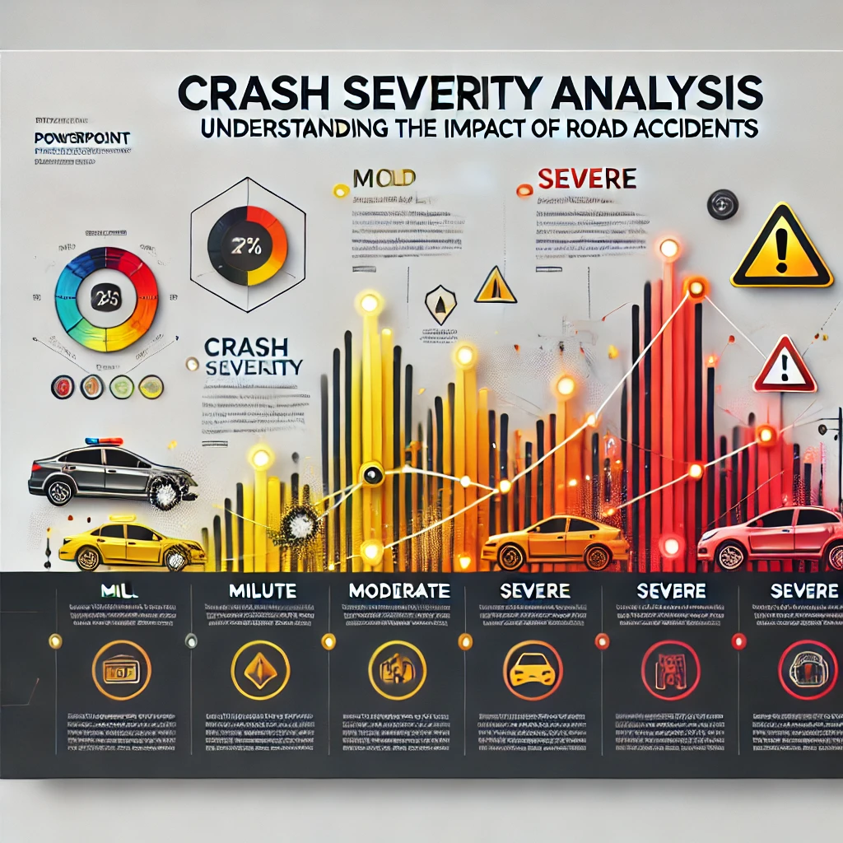
Title: "Crash Severity Analysis: Understanding the Impact of Road Accidents.“

Slide 3
Aims:
Showcase Data Analytics Skills
Demonstrate data cleaning, exploration, and visualization techniques.
Apply statistical and machine learning models (if applicable) to predict crash severity.
Present findings in a structured and compelling way, useful for stakeholders in transportation and public safety.
Visualize Data for Decision-Making by Presenting clear and insightful visualizations (charts and graphs) to communicate findings.
Provide a data-driven approach to understanding accident severity and its impact.
Software Tools and Technologies
Visual Studio Code (Integrated Development Environment)
Python Programming Language and Libraries (Pandas, Numpy, Matplotlib, Seaborn, Sklearn) for Data Cleaning, Processing, Data Visualisation, Statistical Analysis and Machine Learning.
Jupyter Note Book
Microsoft Power Point
Visualisations.
Bar Charts

Slide 4
Project Background
Road accidents are a major public safety concern, often leading to loss of life, injuries, and financial burdens. Understanding crash severity and its influencing factors is crucial for improving road safety policies, vehicle design, and driver awareness. This project analyzes automobile crash data to uncover patterns in crash severity based on vehicle attributes, driver demographics, environmental conditions, and road surface factors. By leveraging data analytics, this study aims to provide insights that can help policymakers, automotive manufacturers, and insurance companies implement better safety measures.
Business & Policy Implications
How can insurance companies use crash severity insights to adjust premiums?
What safety measures can be recommended to reduce high-risk crashes?
How can authorities improve road safety regulations based on data insights?
This study will use data visualizations, statistical analysis, and predictive modeling to provide actionable recommendations for reducing crash severity and improving road safety.

Slide 5
Project Requirements / Business Questions
This project seeks to answer key business and safety-related questions, including:
What is the relationship between driver age, vehicle age and crash severity?
2. Which vehicle types and makes are associated with the highest crash severity?
3. What is the trend of the number of crashes throughout the week and in the different times of the day ?
4.Which weather condition is associated with the highest number of automobile crashes?
5. Hypothesis Test:
Older vehicles tend to have larger engine displacement compared to newer vehicles
6. Machine Learning Business Question. Which top 3 features have the most impact on the crash severity?

Slide 6
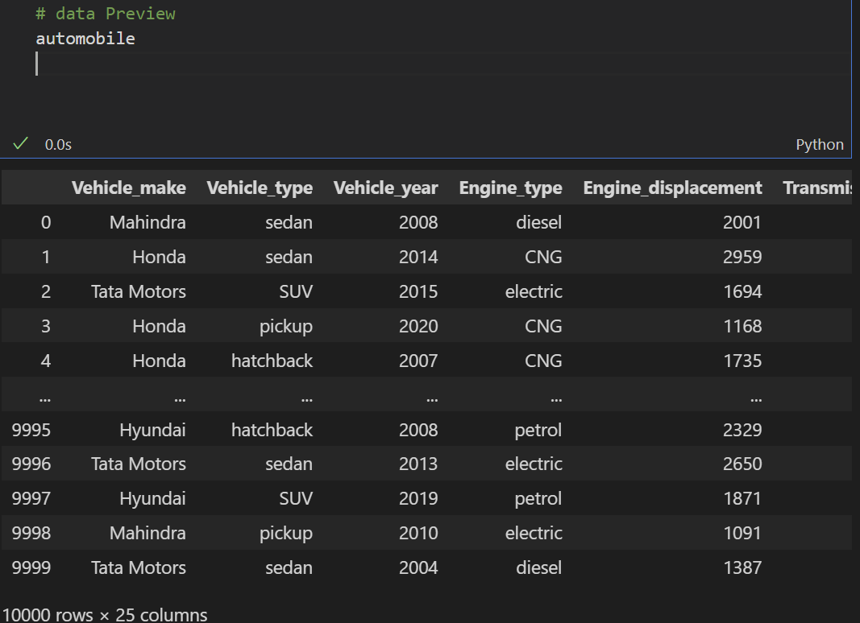
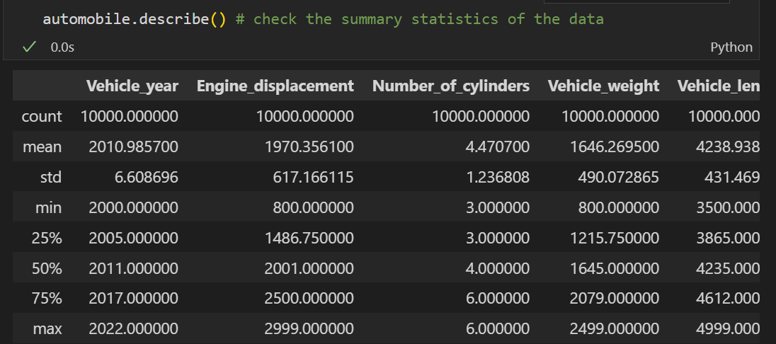
Data Description (Automobile_crash_data)
Automobile Dataset consist of Objects and Int64
Automobile.describe

Slide 7
Data Cleaning and Preparation (Data Cleaning Pipeline)
Inconsistencies
Missing Values
Duplicate Values
Outliers
Feature Engineering
Correlated Features
To answer business questions, extract useful insights, perform data analytics and machine learning we need to clean the data using the data cleaning pipeline

Slide 8
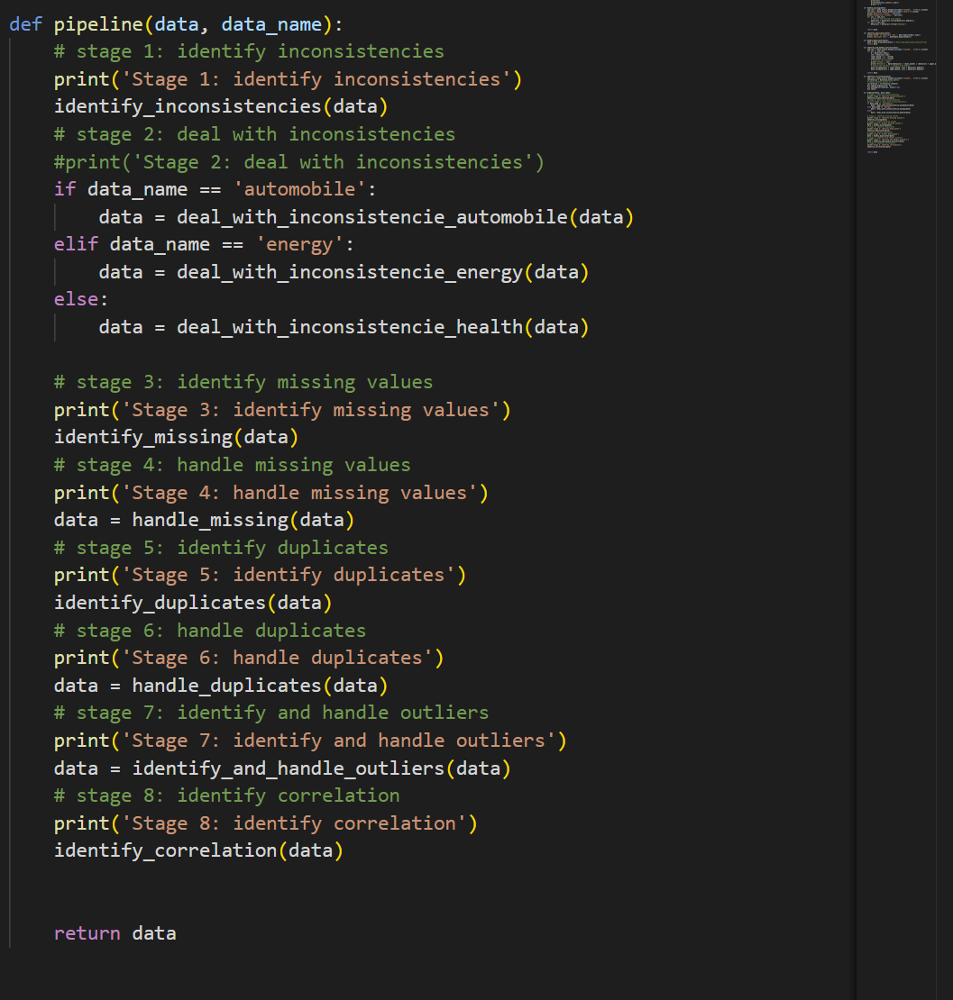
Data Cleaning pipeline Automated

Slide 9
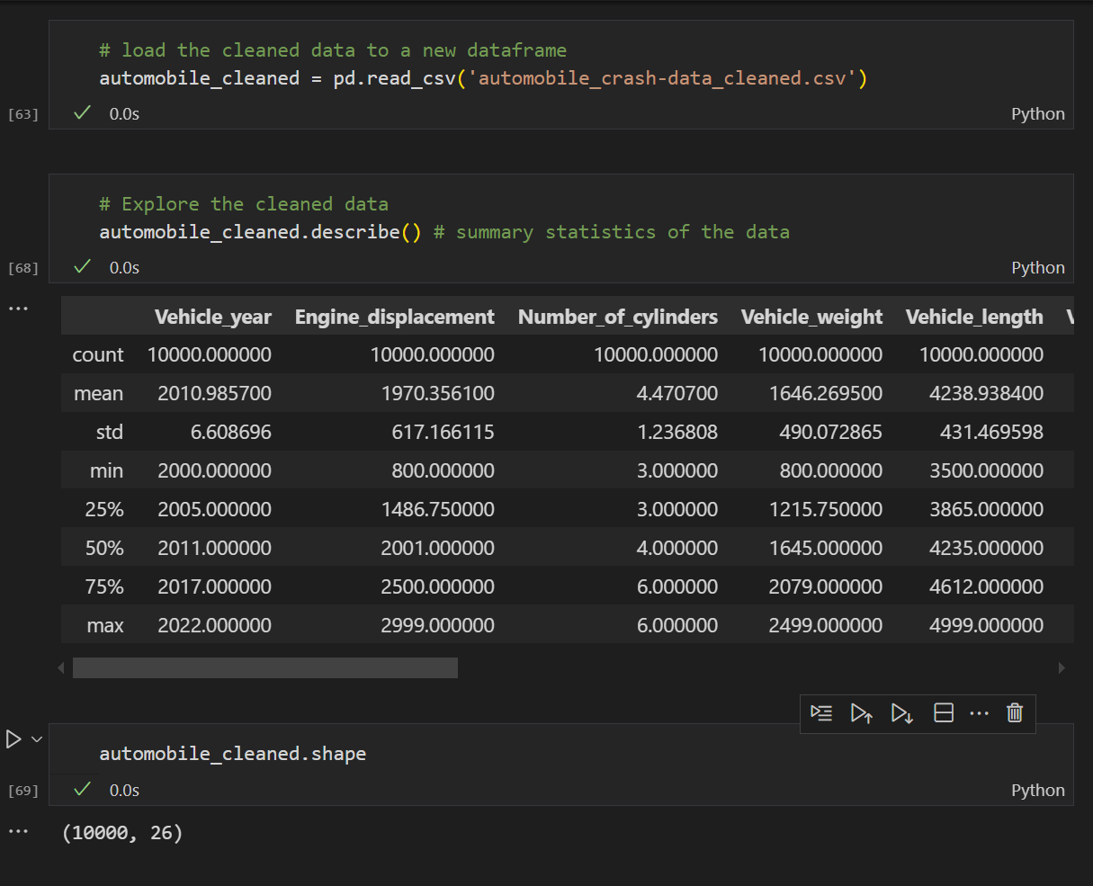
Brief Description of Cleaned Automobile Data

Slide 10
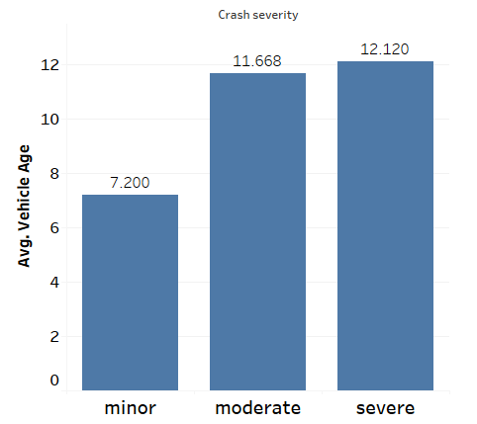
Answers to Business Questions: What is the relationship between vehicle age and crash severity ?
Findings:
Drivers with older vehicles are more likely to sustain severe injuries in crashes compared to those in newer models.
Automotive manufacturers and dealerships can leverage this information to promote the safety benefits of newer vehicles, potentially boosting sales. Insurance companies might consider adjusting premiums based on vehicle age to reflect the increased risk associated with older cars.

Slide 11
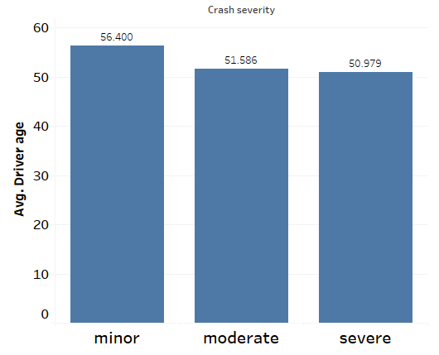
1.1. What is the relationship between driver age and crash severity ?
Findings:
Higher risk-taking behavior for younger drivers
Older drivers are more likely to be involved in minor crashes.

Slide 12
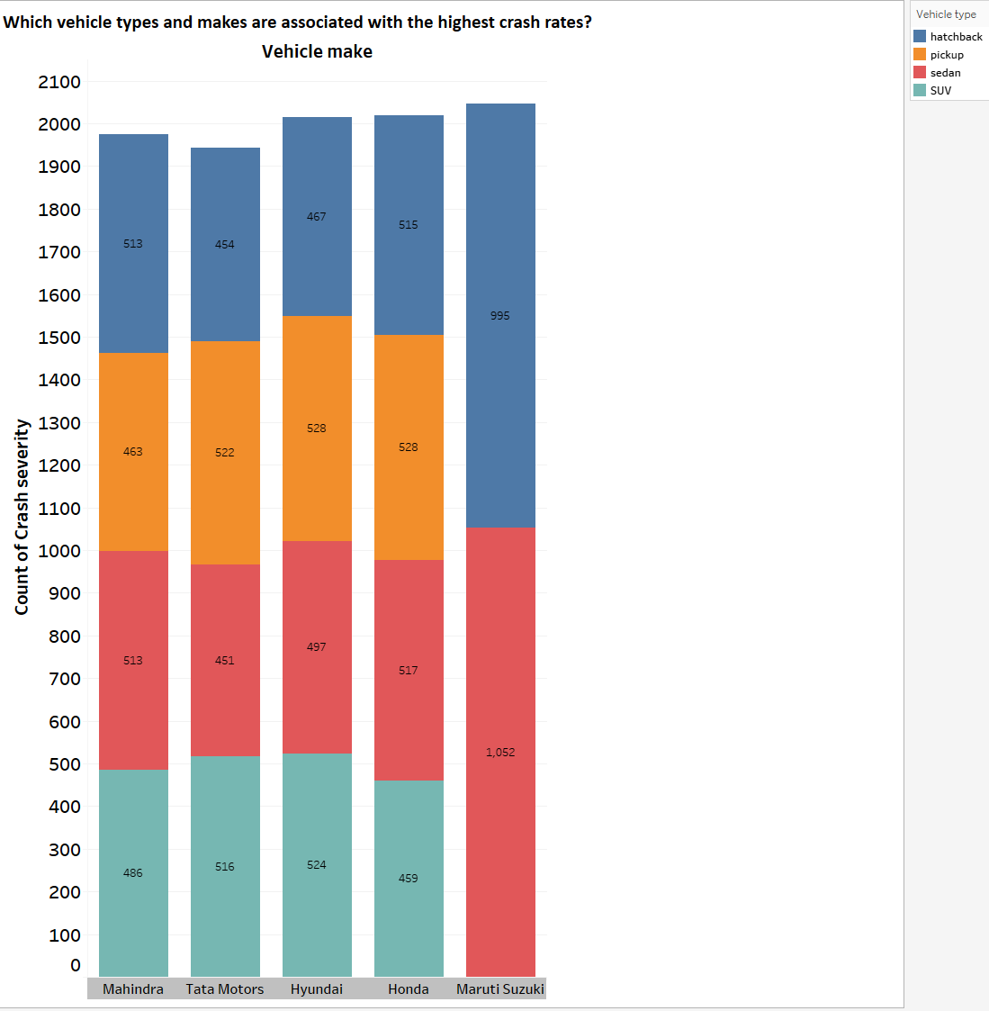
2.2. Which vehicle types are associated with the highest crash rates?
Findings
Among all the vehicle makes, Maruti Suzuki has the highest total count of crash severity, with a significant contribution from sedans (1,052) and SUVs (995).
SUVs have the highest crash severity counts across most makes. This trend is consistent across these four vehicle makes.
Sedans have a significant impact on crash severity for Maruti Suzuki: Unlike other vehicle makes where SUVs dominate the crash severity counts, Maruti Suzuki has a notably high crash severity count for sedans (1,052), which is the highest single count for any vehicle type across all makes.

Slide 13
What is the trend of the number crashes throughout the week and in different times of the day?
Reason: Identifying High-Risk Time Periods
Certain days of the week or times of the day might show higher crash rates. For example:
Weekdays: Increased crashes during rush hours due to heavy commuter traffic.
Weekends: Higher crashes at night due to recreational activities and potential alcohol consumption.
Knowing this trend helps authorities focus safety measures on high-risk periods.
Visualization: Bar Chart for Days of the week and Time of the day

Slide 14
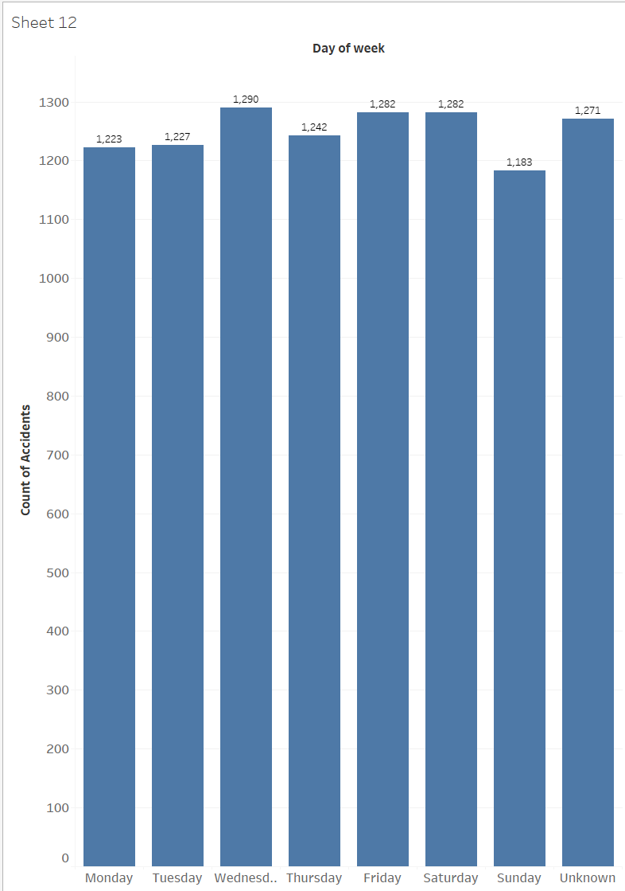
Findings:
Wednesday (1,290 accidents) has the highest number of accidents, closely followed by Saturday and Friday.
Sunday (1,183 accidents) has the lowest accident count. This suggests reduced activity, possibly due to less commuting or fewer business operations.
Accident counts are relatively consistent from Monday through Friday (ranging between 1,223 and 1,290).
The "Unknown" day category (1,271 accidents) highlights incomplete or unclear data.

Slide 15
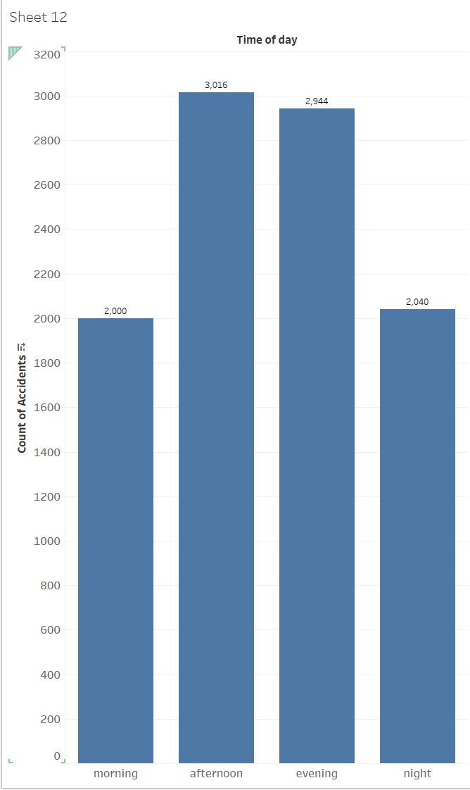
Business Insights and Findings:
The afternoon (3,016 accidents) and evening (2,944 accidents) see the highest number of accidents. The afternoon is therefore a high risk period.
Businesses should focus on implementing safety measures, such as increased traffic control or targeted safety campaigns, during these periods.
The morning (2,000 accidents) and night (2,040 accidents) have significantly fewer accidents compared to afternoon and evening. This times represent low risk.

Slide 16
Which weather condition is associated with the highest number of automobile crashes?
This question aims to identify which weather condition leads to the most crashes, providing insight into which conditions might need more focus for improving road safety.

Slide 17
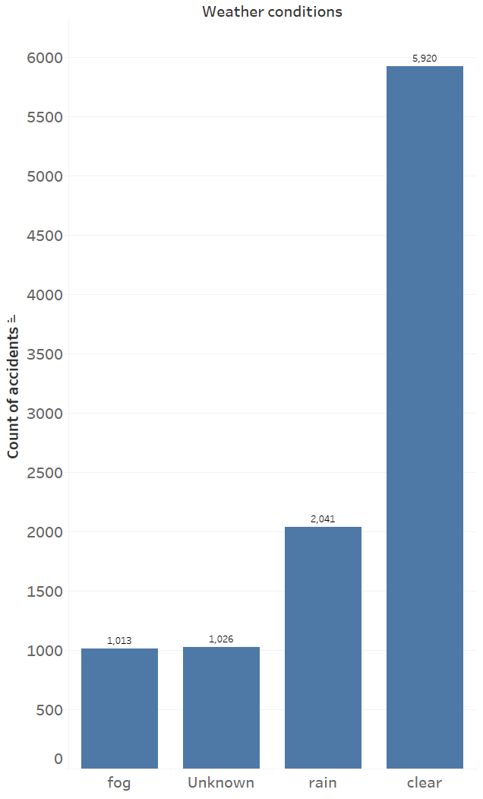
Findings:
The bar chart indicates that clear weather conditions are associated with the highest number of automobile crashes, totaling 5,920. This suggests that despite the assumption that clear weather is safer for driving, it may also be linked to higher traffic volumes and possibly driver complacency, leading to more accidents.
Rainy weather conditions account for the second-highest number of crashes, with 2,041 incidents. Rain reduces visibility and road traction, contributing to a higher risk of accidents. This emphasizes the need for drivers to exercise increased caution and for improved road infrastructure during rainy conditions.
Both fog and unknown weather conditions have relatively lower counts of automobile crashes, with 1,013 and 1,026 crashes respectively. While these numbers are lower compared to clear and rainy weather conditions, they still indicate that fog can significantly impair visibility, and there may be a lack of data or reporting accuracy for unknown conditions.

Slide 18
Correlation Analysis
Correlation is a statistical measure that quantifies the degree to which two variables change together. Correlation is only calculated for numerical features. It ranges from -1 to +1, where:
+1: Perfect positive relationship (both variables increase together).
-1: Perfect negative relationship (one increases as the other decreases).
0: No linear relationship.
key factors that contribute to severe accidents can be identified and would help in feature selection for predictive modeling.
Avoiding Misleading Assumptions. Correlation ≠ causation. For example, a positive correlation between Driver Age and Crash Severity might reflect older drivers’ slower reaction times, but it could also be confounded by older vehicles lacking safety features. Solution: Use domain knowledge and additional tests (e.g., hypothesis testing) to validate causality

Slide 19
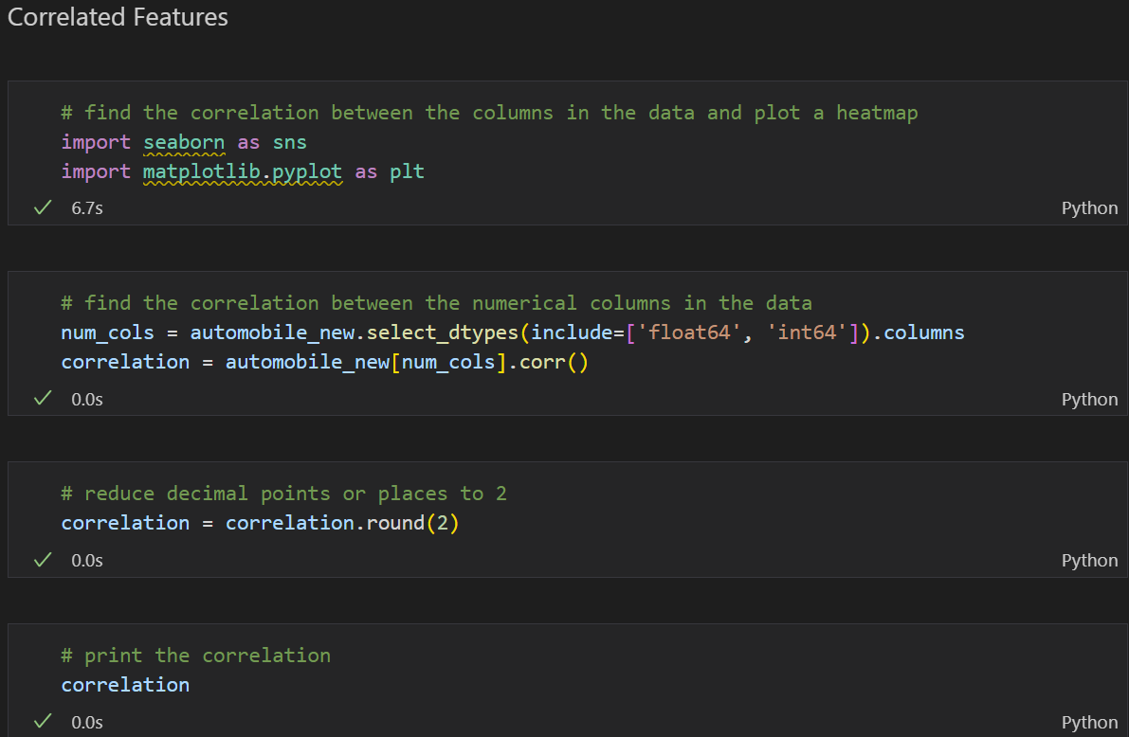
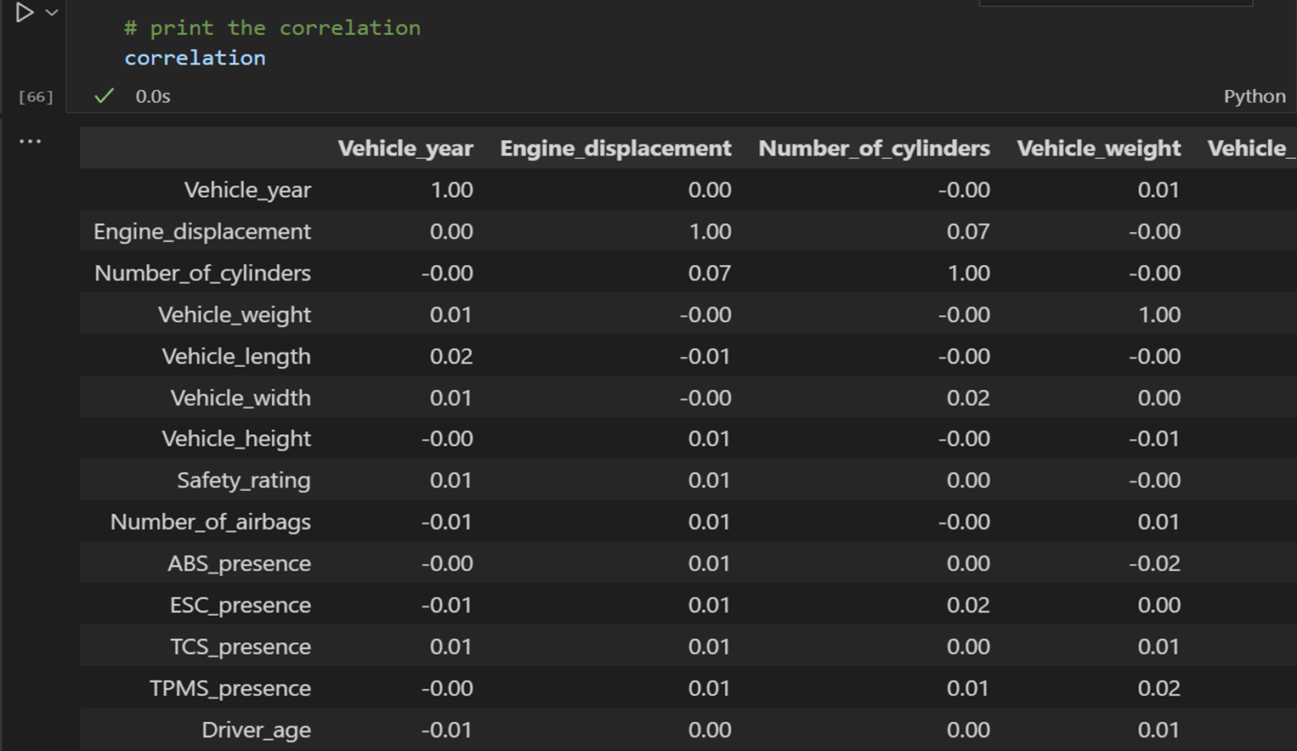
Correlation Analysis for all the features

Slide 20
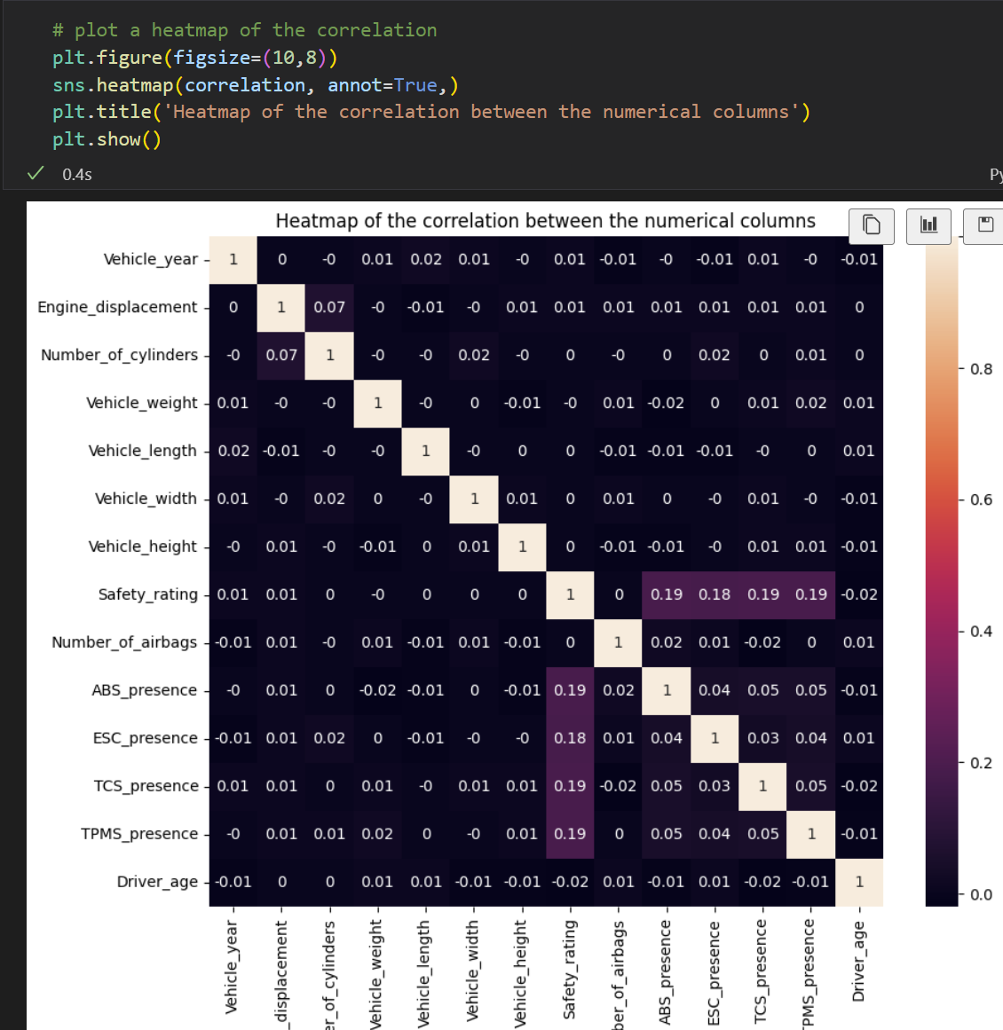
The Automobile data would have be taken through the data cleaning pipeline as seen on slide 7. The correlation is calculated only for numerical features. From this dataset there are no features which are correlated. The 1 in the heat map is because we were comparing vehicle year with vehicle year.

Slide 21
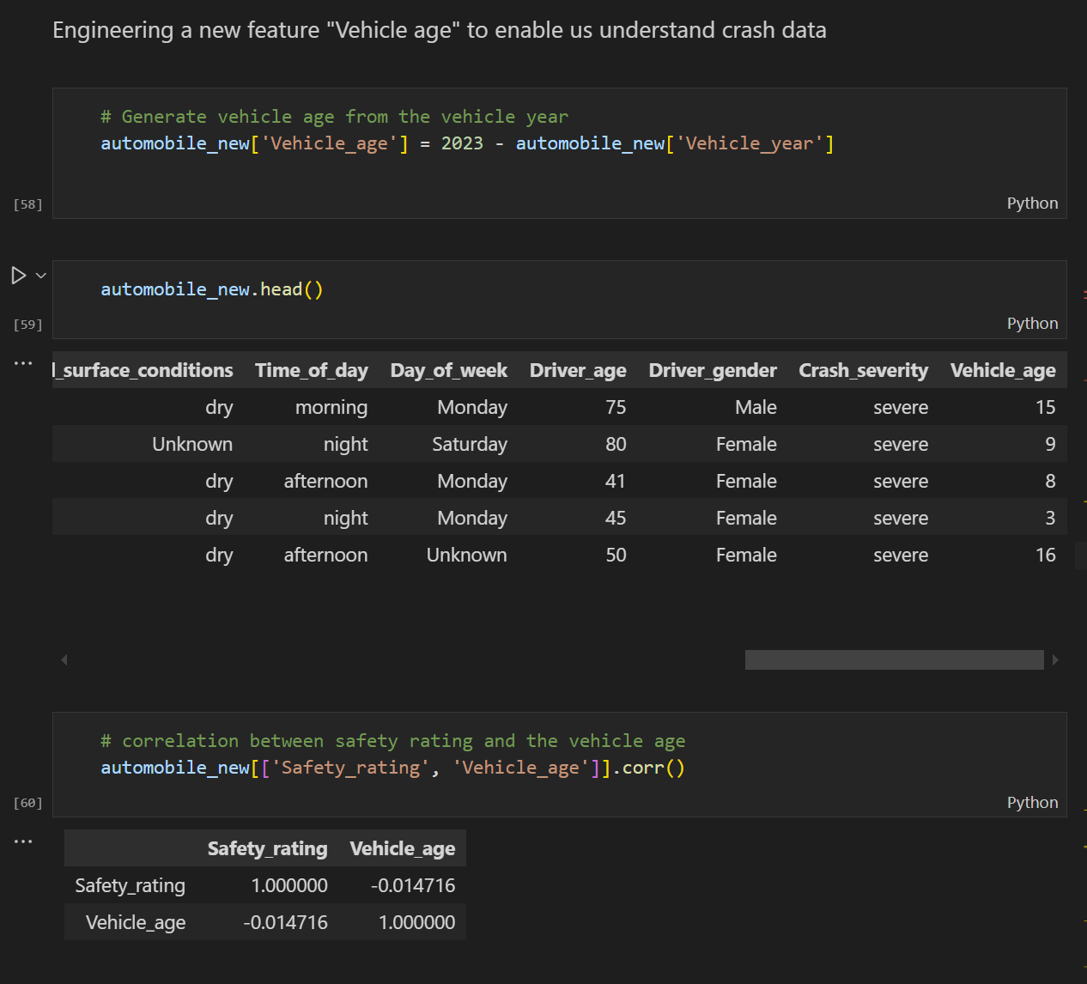
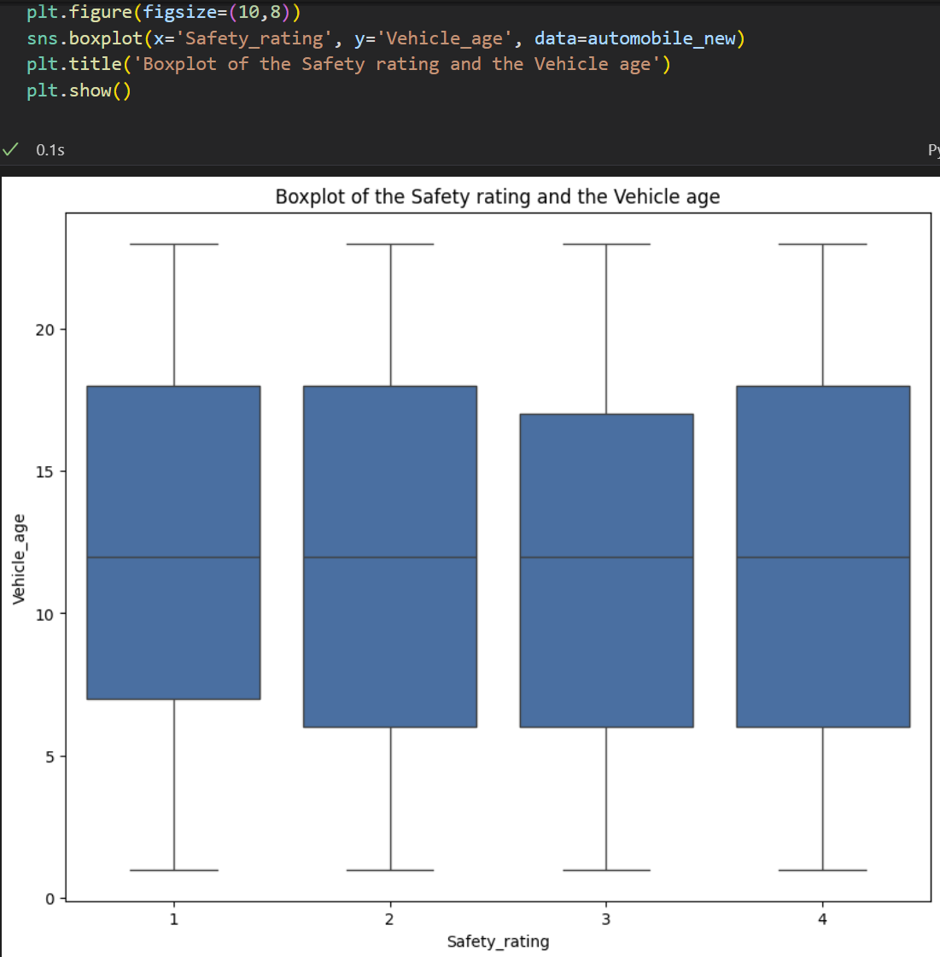
The boxplot provides insights into the relationship between Safety_rating (1-4) and Vehicle_age (0-20 years).
2. The median age of vehicles remains consistent across different Safety Ratings. This suggests that Safety Rating does not have a strong influence on the age of the vehicle. The boxplot does not show individual points outside the whiskers, meaning there are no significant outliers in the dataset. There is therefore no clear relationship between Safety Rating and Vehicle Age from this boxplot.

Slide 22
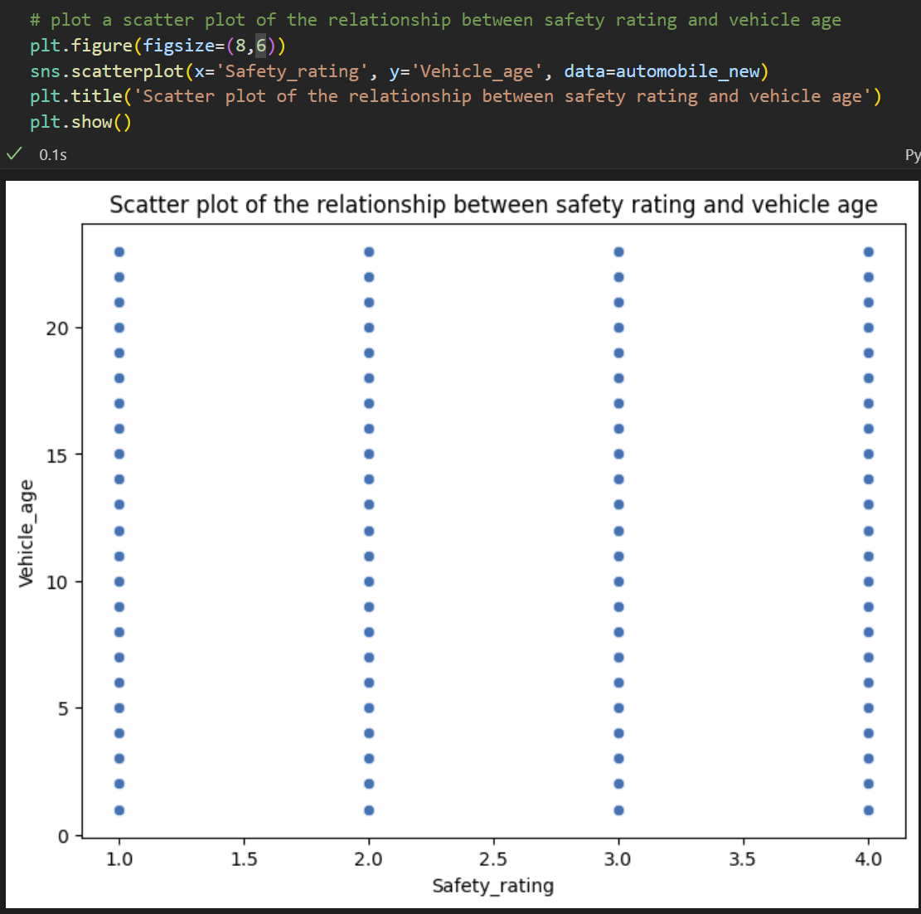
The scatter plot provides a quick visual representation of the relationship between the two variables. If there were a trend (e.g., older vehicles having lower safety ratings), it would be visible in the scatter plot. However, in this case, no such trend is apparent. Since the scatter plot shows no clear relationship, it suggests that the correlation coefficient (calculated in the code) will likely be close to zero, confirming a weak or no linear relationship.
The Safety Rating values (1, 2, 3, and 4) are discrete categories rather than continuous values.
This is why the data points form vertical columns at each Safety Rating level instead of being spread across the x-axis. This scatter plot suggests that Vehicle Age does not significantly impact Safety Rating

Slide 23
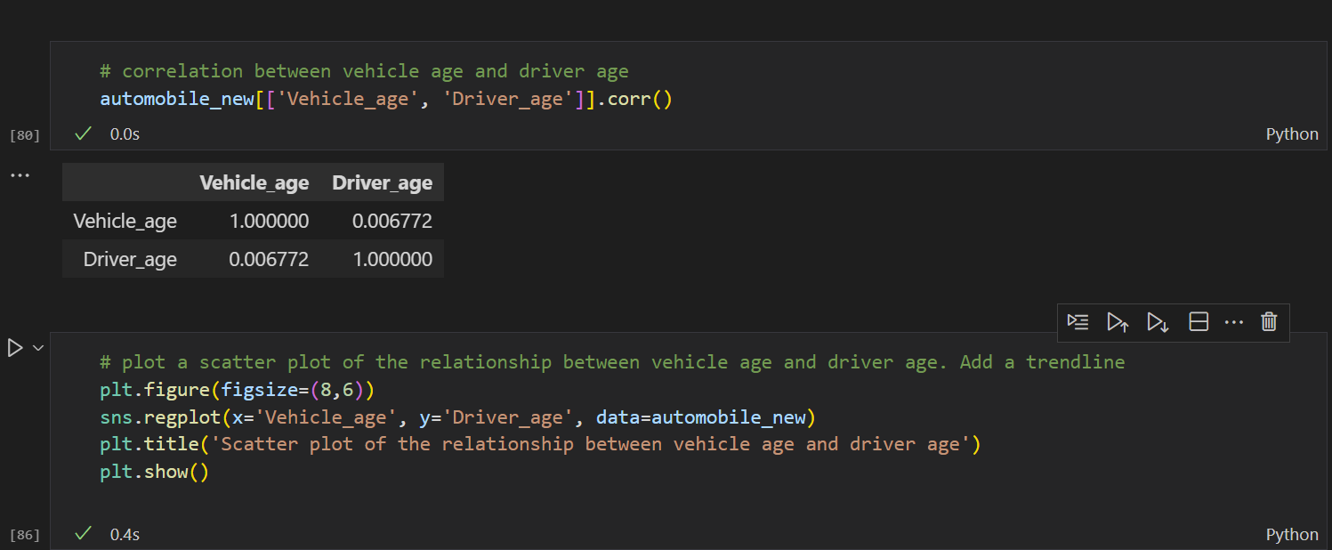
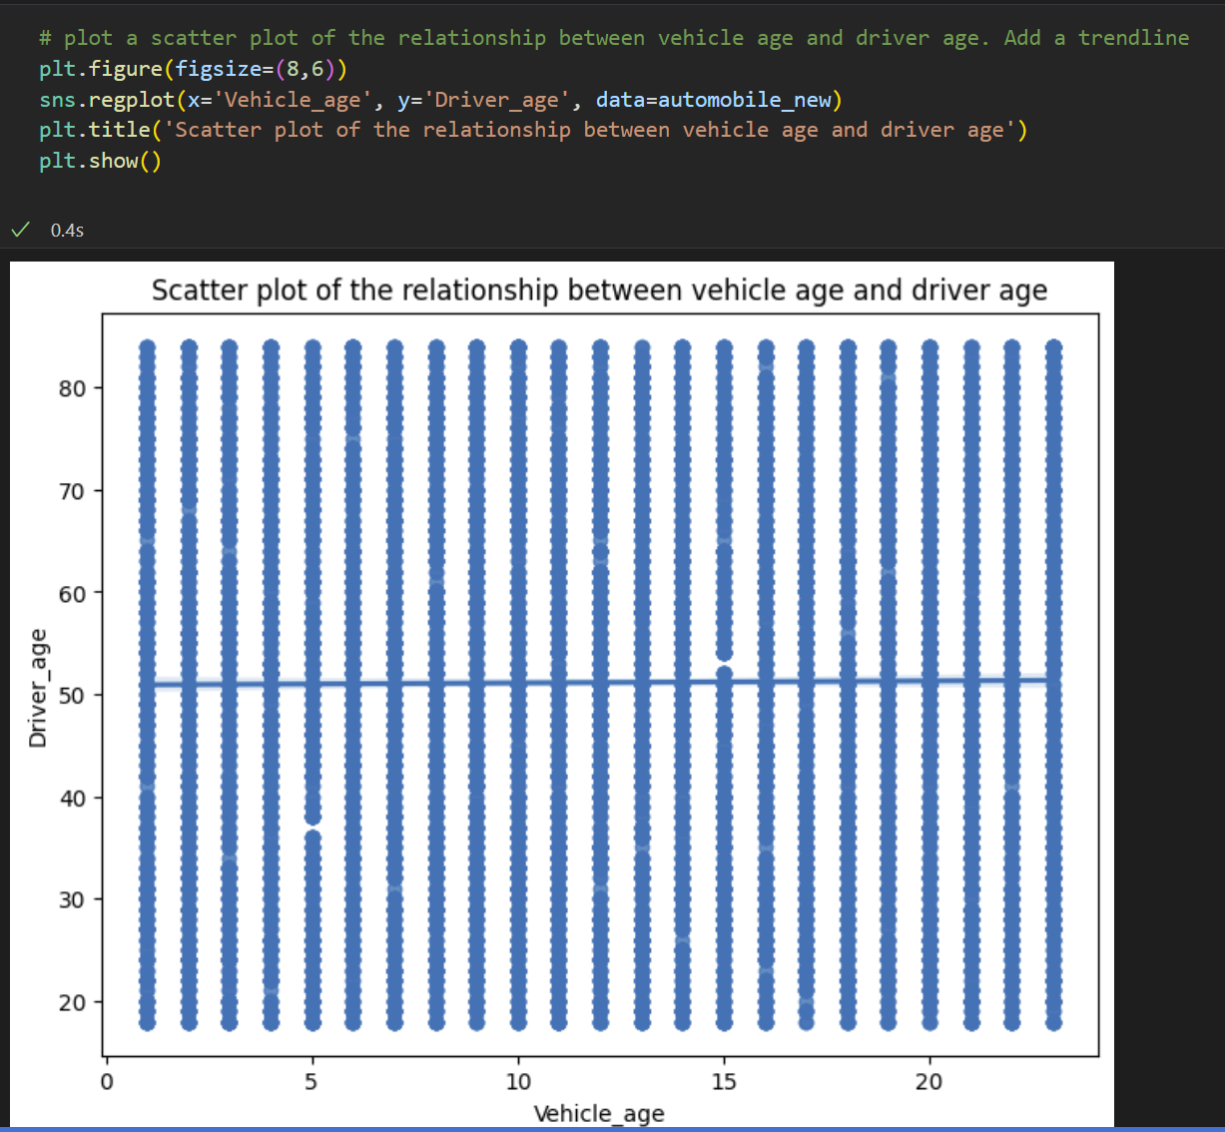
The correlation coefficient between Vehicle Age and Driver Age is 0.006772.Since this value is very close to 0, it suggests almost no correlation between vehicle age and driver age.
The scatter plot visualizes the relationship between Vehicle Age (x-axis) and Driver Age (y-axis).The regression line appears nearly flat or level, confirming that there is no meaningful trend between the two variables.
There is no strong relationship between the age of a vehicle and the age of its driver.

Slide 24
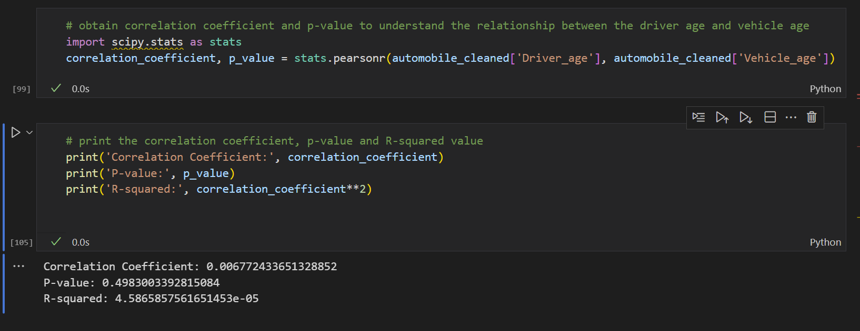
A correlation of 0.0068 is extremely close to 0, meaning almost no relationship exists between Vehicle Age and Driver Age.
The P-value tests the statistical significance of the correlation. P = 0.4983 (49.83%) is much higher than 0.05.This means that the correlation is not statistically significant—the observed correlation (0.0068) could have happened by random chance.
R-squared (R²) measures how much variation in Driver Age can be explained by Vehicle Age. R² = 0.0000459 (≈ 0%) means Vehicle Age explains almost none (0.00459%) of the variation in Driver Age.In other words, knowing the vehicle's age tells us nothing useful about the driver's age.
No meaningful correlation between Vehicle Age and Driver Age.

Slide 25
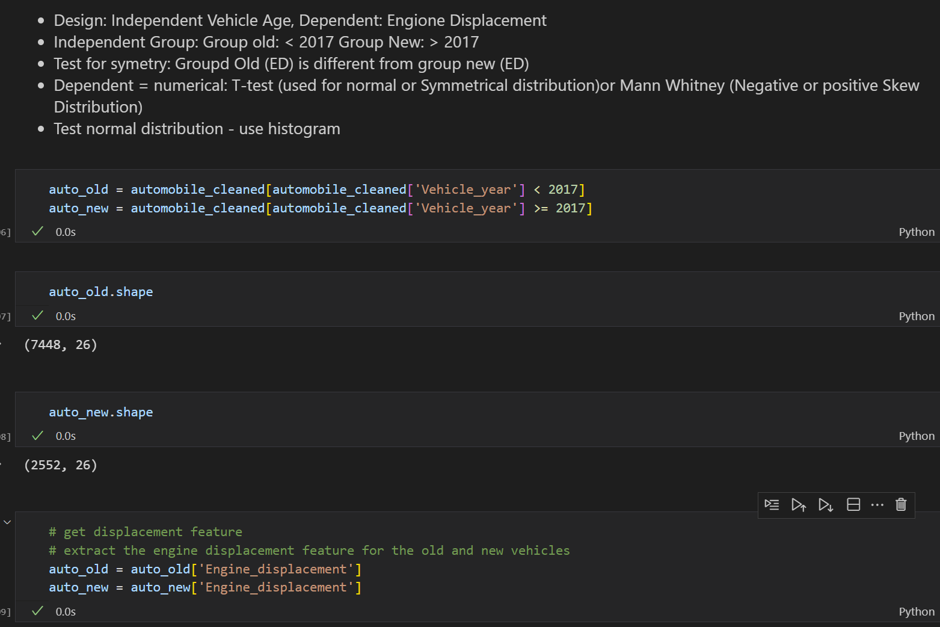
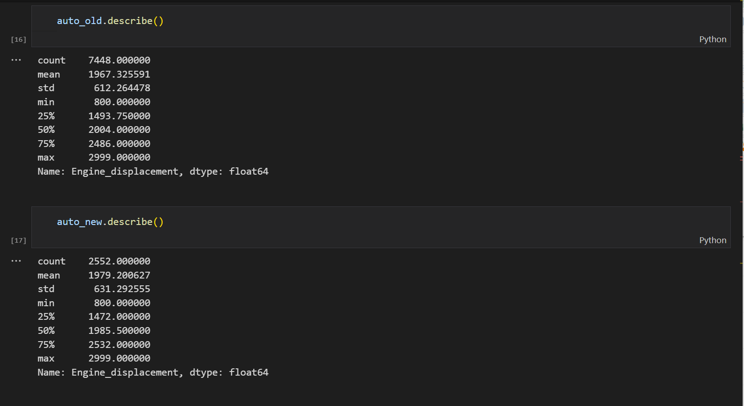
Hypothesis Test: Older vehicles tend to have larger engine displacement compared to newer vehicles

Slide 26
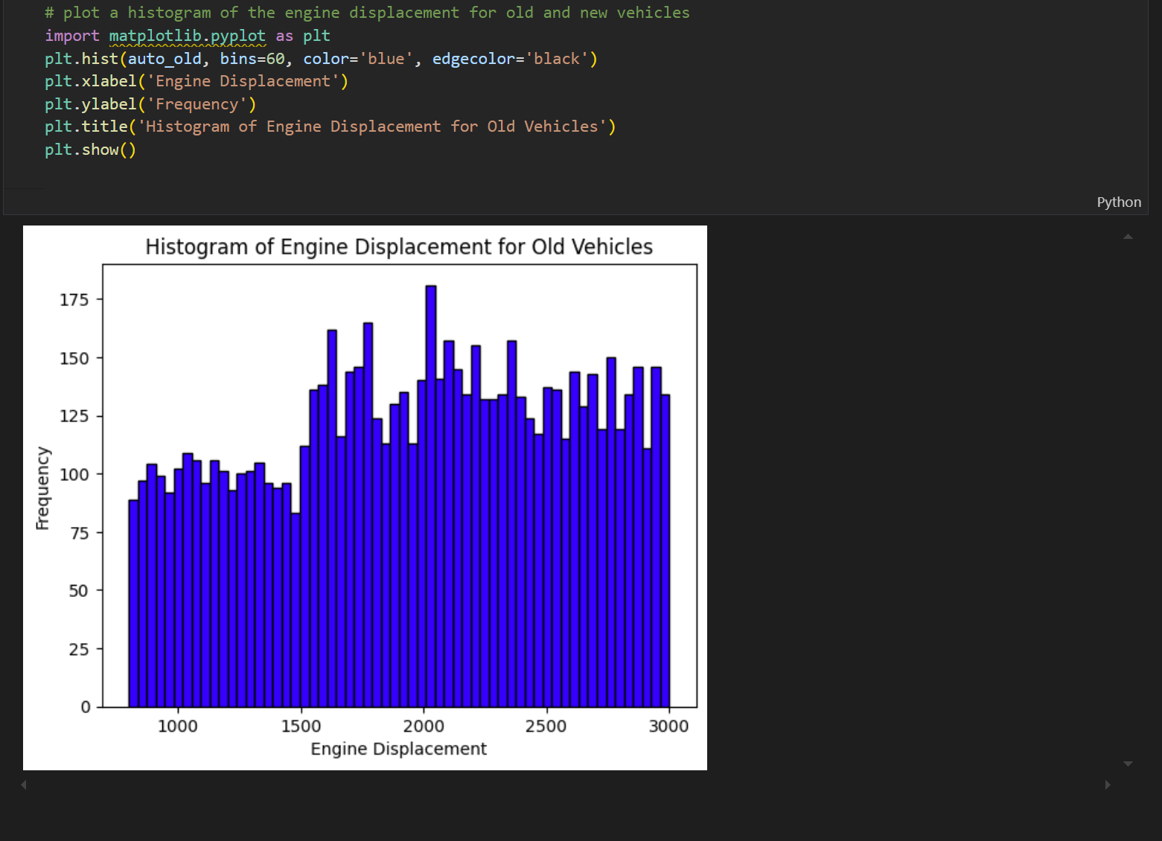

Slide 27
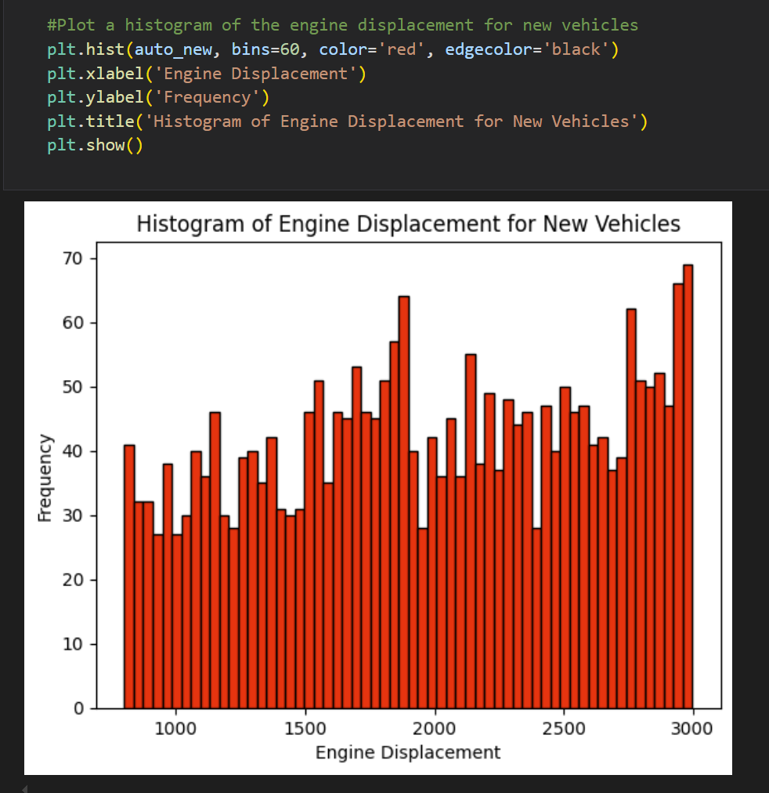

Slide 28
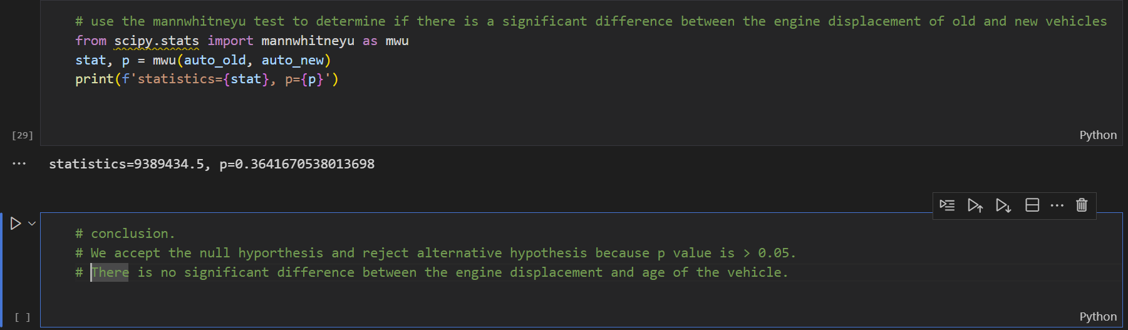
The p-value helps determine whether to reject or accept the null hypothesis: - If p > 0.05, we fail to reject the null hypothesis, meaning there is no significant difference. - If p ≤ 0.05, we reject the null hypothesis, indicating a significant difference. It helps assess whether vehicle age (old vs. new) has an impact on engine displacement, which could be important for design, performance, or regulatory considerations. In this case, since the p-value is greater than 0.05, the conclusion is that there is no significant difference between the engine displacement of old and new vehicles. This suggests that vehicle age does not significantly affect engine displacement.

Slide 29
Machine Learning
Machine Learning (ML) is a branch of Artificial Intelligence (AI) that enables computers to learn from data and improve their performance over time without being explicitly programmed. It involves using algorithms to identify patterns in data and make predictions or decisions based on those patterns.
Business Question (Classification, where outcome is categorical):
Which top 5 features have the most impact on the crash severity?

Slide 30
Data Collection
Purpose: Gather raw data from various sources (e.g., databases, APIs, sensors, or user inputs).
Example: Collecting customer transaction records for fraud detection.
Data Cleaning & Modelling
Data Cleaning: Process raw data to handle missing values, outliers, duplicates, or inconsistencies.
Modelling: Prepare data for training by defining features (feature engineering) and splitting into training/test sets.
Example: Removing invalid entries and creating features like "average transaction amount."
Model Training
Purpose: Train machine learning algorithms (e.g., decision trees, neural networks) on the cleaned data to learn patterns.
Example: Using a training dataset to teach a model to predict fraud.
Model Evaluation
Purpose: Assess the model’s performance using metrics like accuracy, precision, recall, or F1-score.
Example: Testing the model on unseen data to ensure it generalizes well.
Data Cleaning and Modelling
Model Training
Model Evaluation
Data Collection

Slide 31
Data Modelling Pipeline
Cleaned Data
Feature Encoding
Feature Selection
Data Splitting
Feature Scaling
Training Process

Slide 32
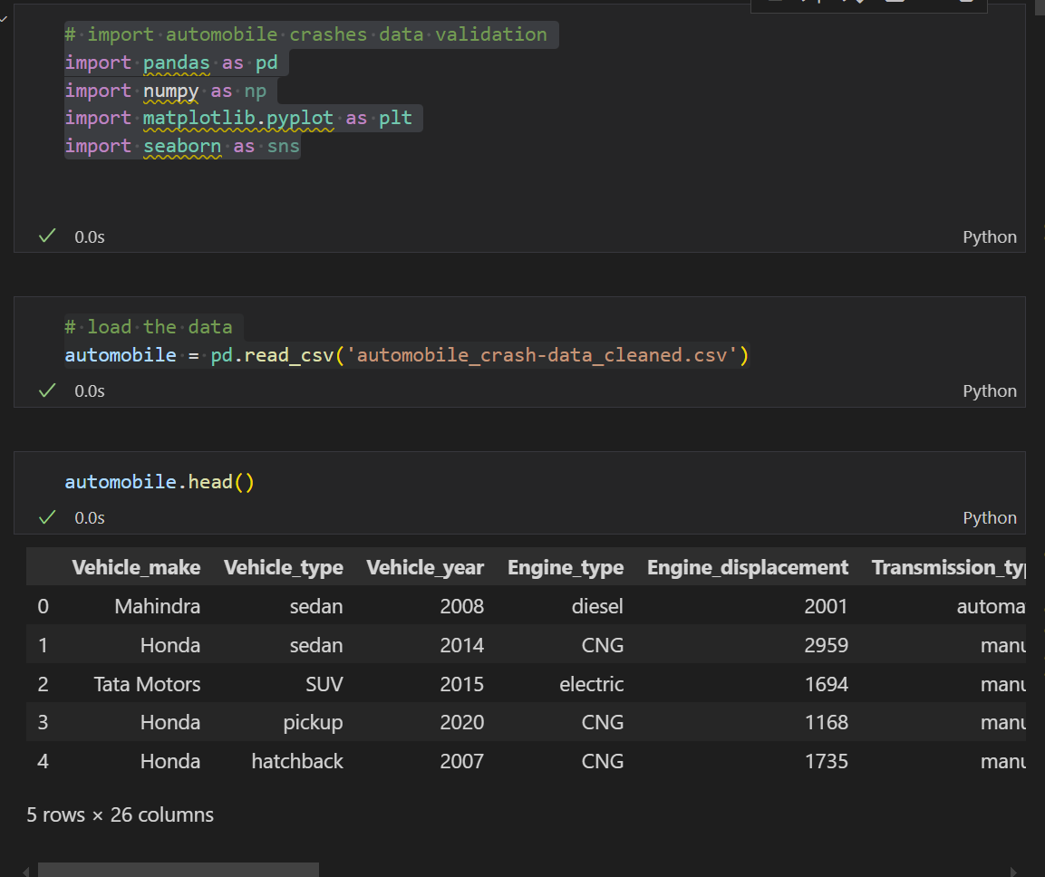
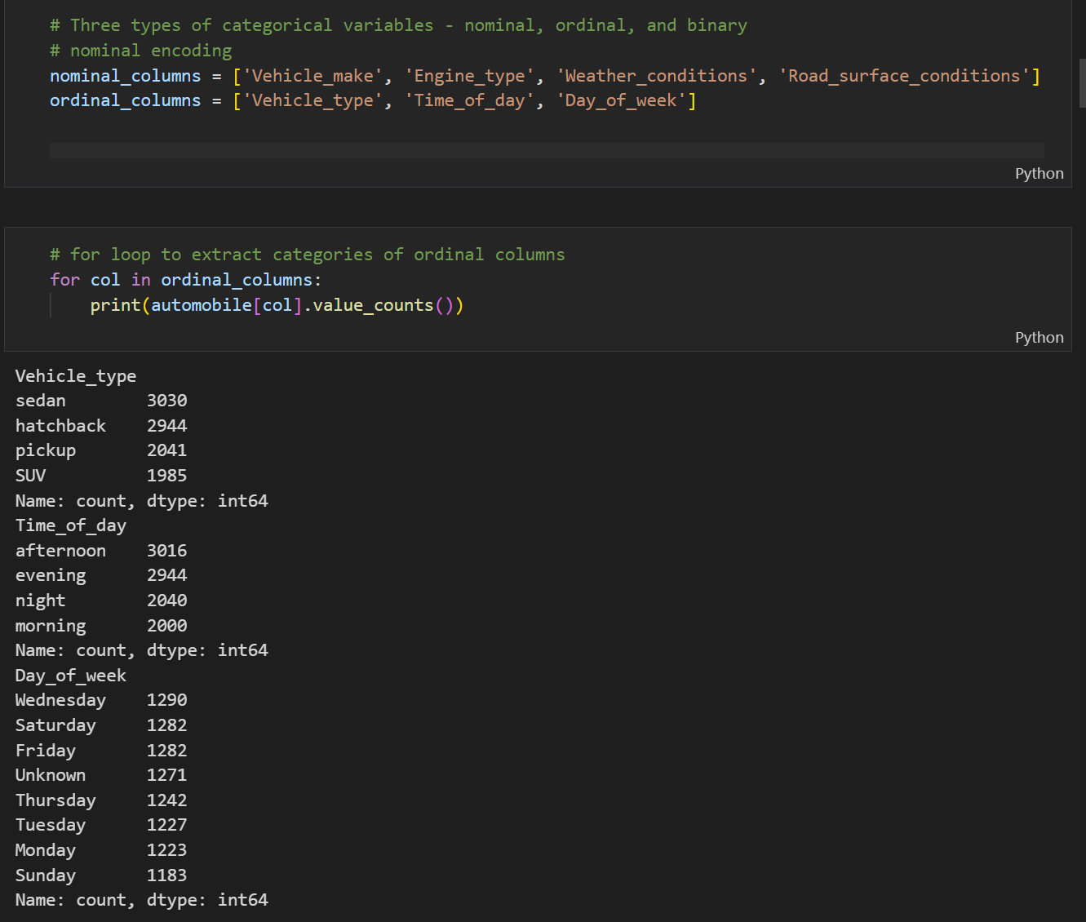
Load Data, clean and Model the data

Slide 33
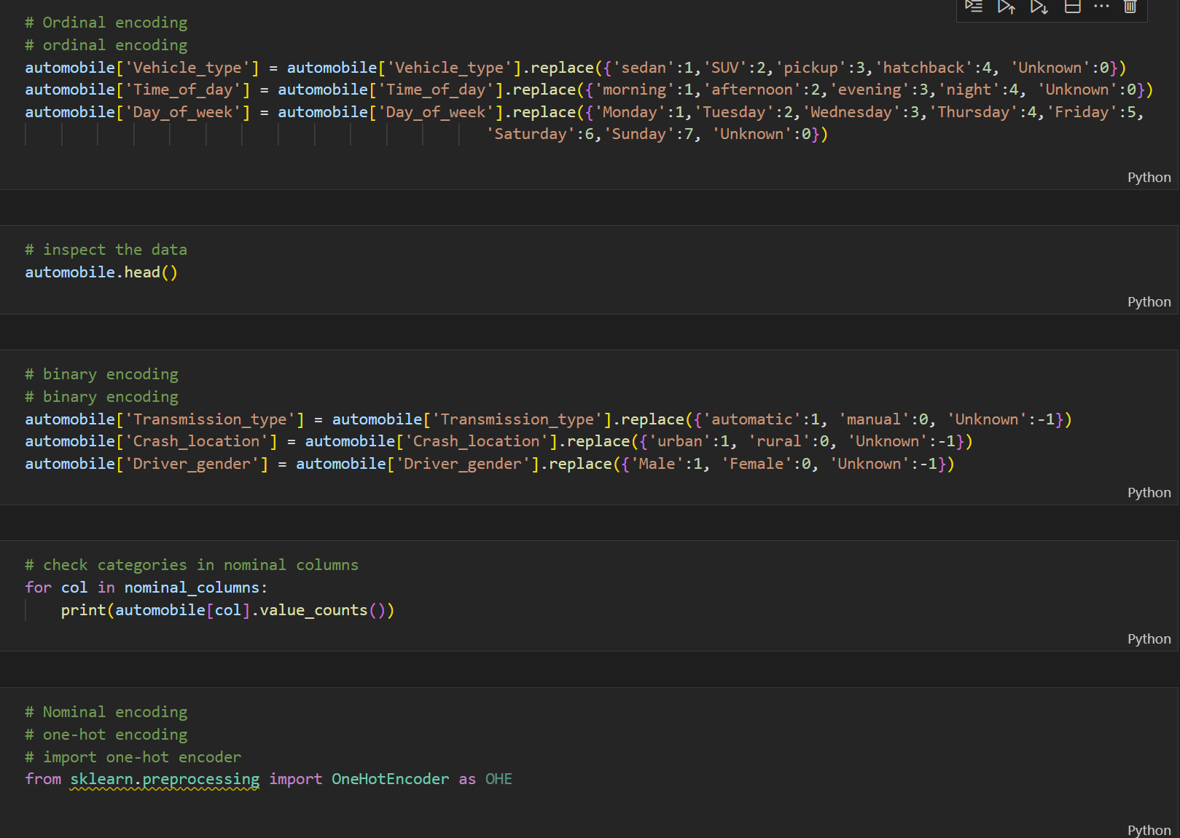
This image demonstrates encoding techniques for categorical data in a machine learning preprocessing workflow

Slide 34
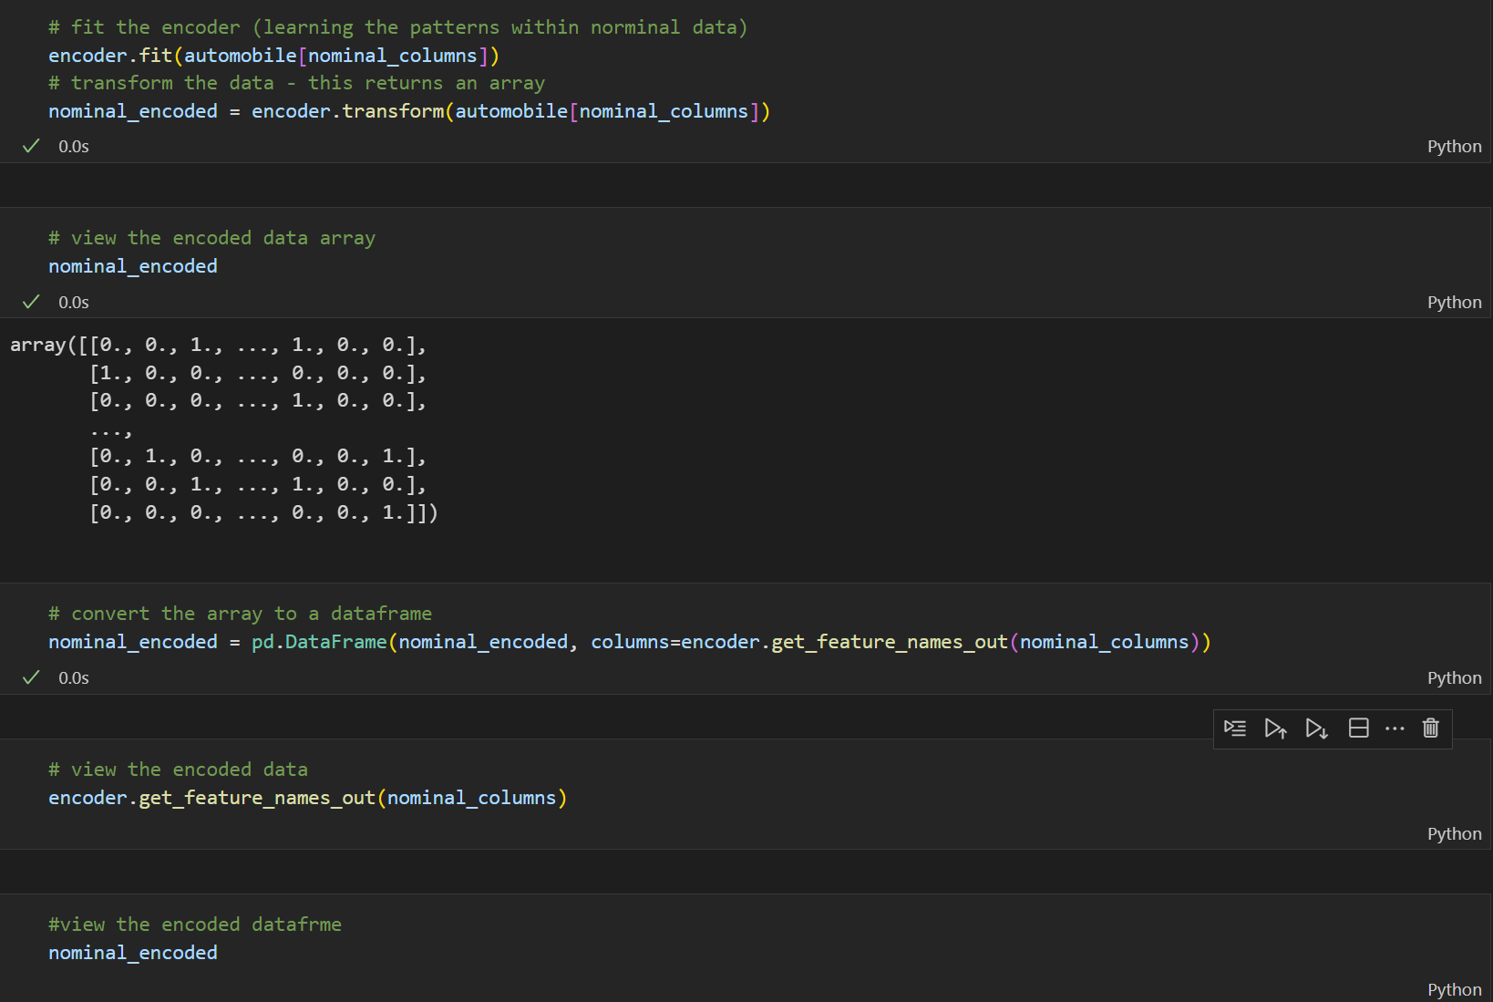
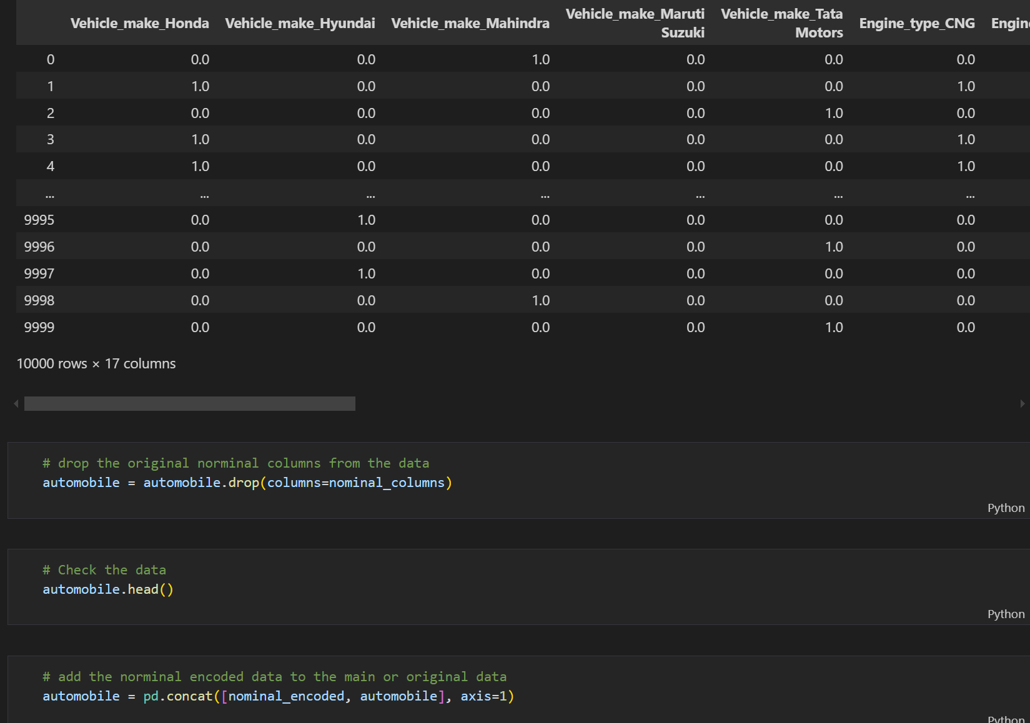
This image shows the one-hot encoding process for nominal categorical data. The key steps are fitting the encoder, transforming the data, converting the array to a DataFrame. This step is critical for handling non-ordinal categories

Slide 35
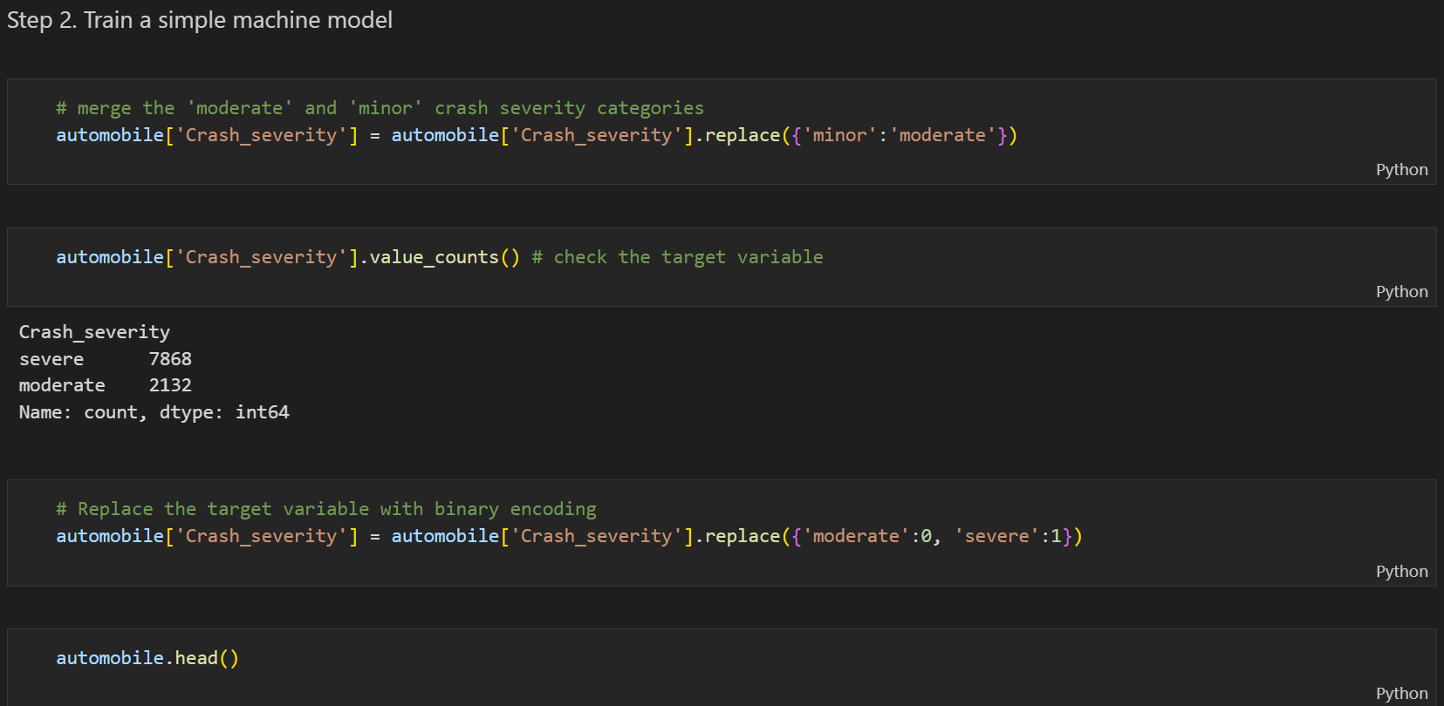
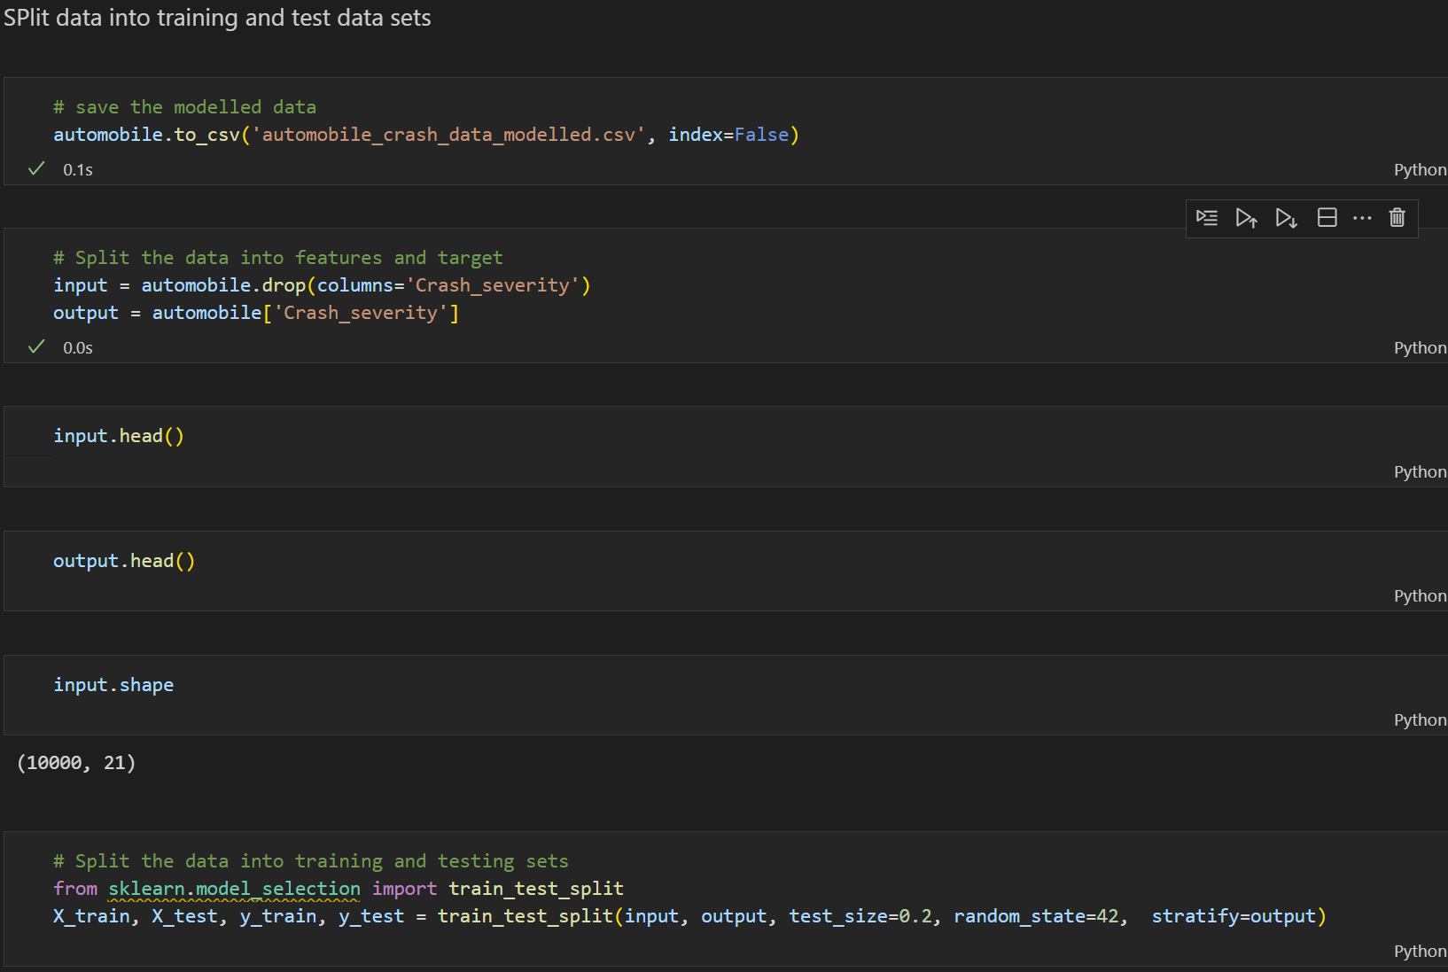
This images highlight preprocessing steps for training a simple model and Splitting data into a training set and a test set.
Data Splitting: Separate features (input) and target (output), then split into training/testing sets (80/20) with stratification to preserve class distribution. Purpose: Prepares data for models like logistic regression or decision trees by ensuring a binary, structured input-output format

Slide 36
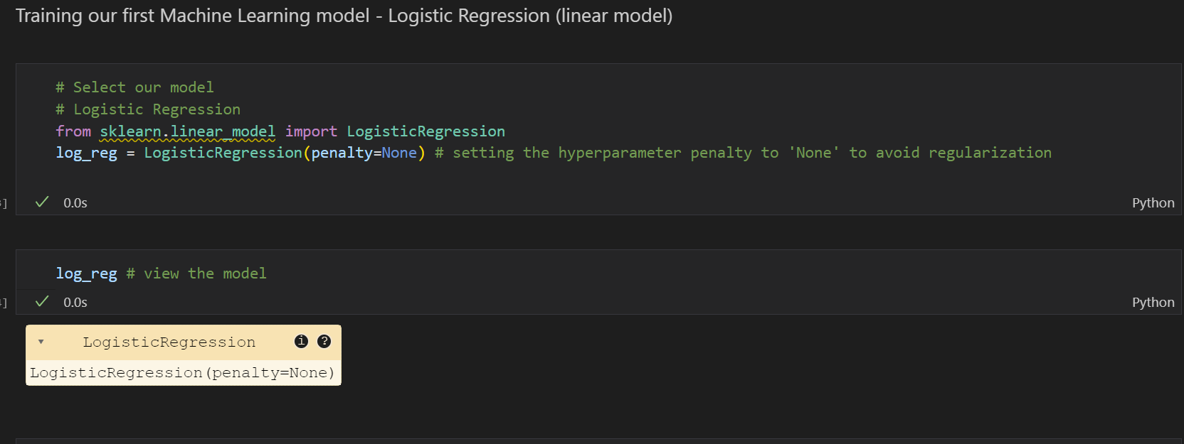
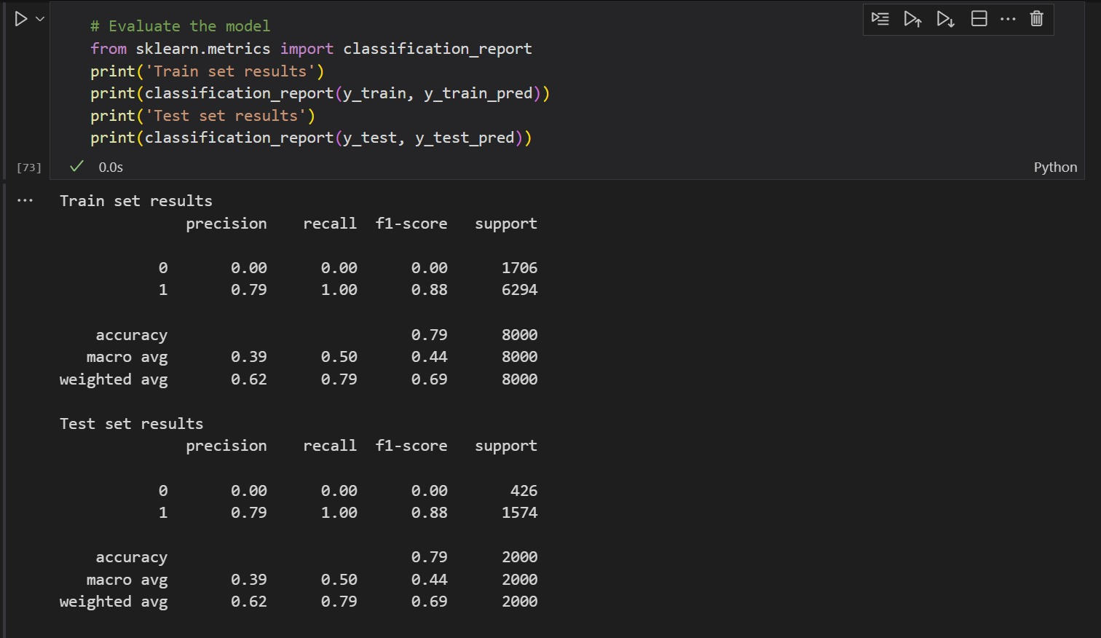
Logistic Regression is a supervised machine learning algorithm used for binary classification problems.
Logistic Regression are simple and can struggle with complex, non-linear relationships
This image evaluates a logistic regression model for a binary classification task (crash severity prediction):
The model completely fails to predict class 0 (crash severity is low), as indicated by precision, recall, and F1-score all being 0.00. The model is underfitting because the training accuracy and test accuracy are far lower than the acceptable performance. Again, the training and test accuracy are very low.

Slide 37
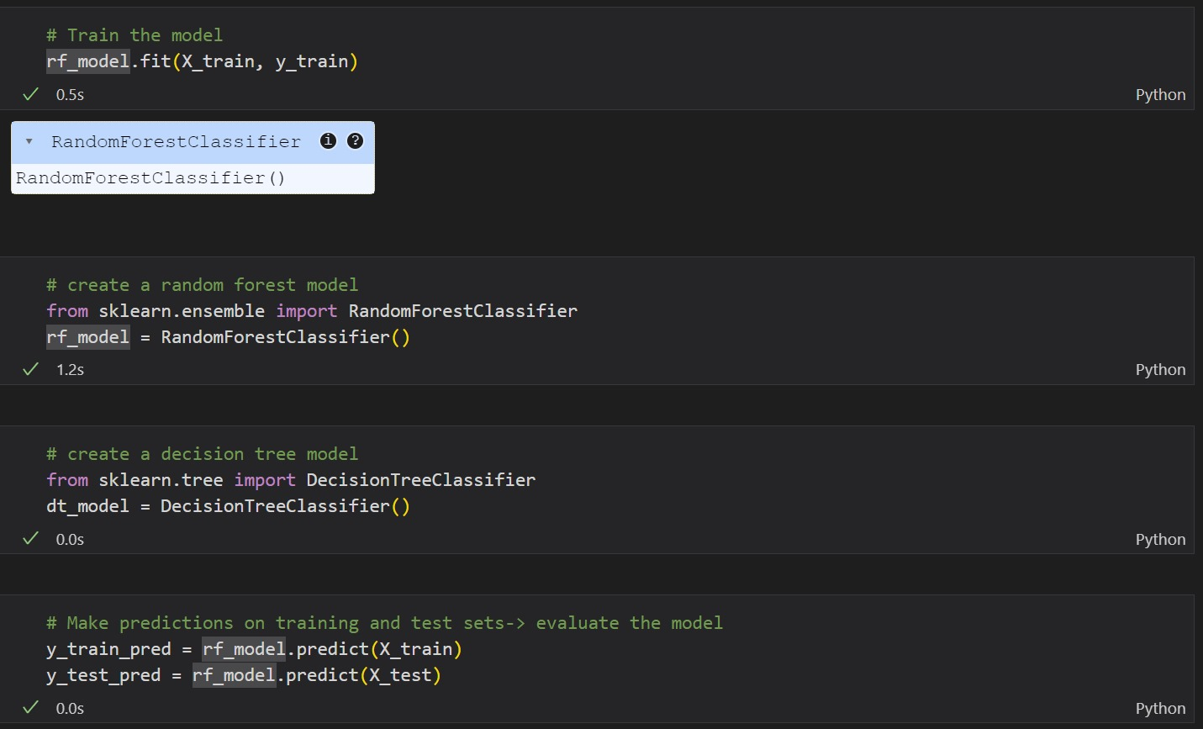
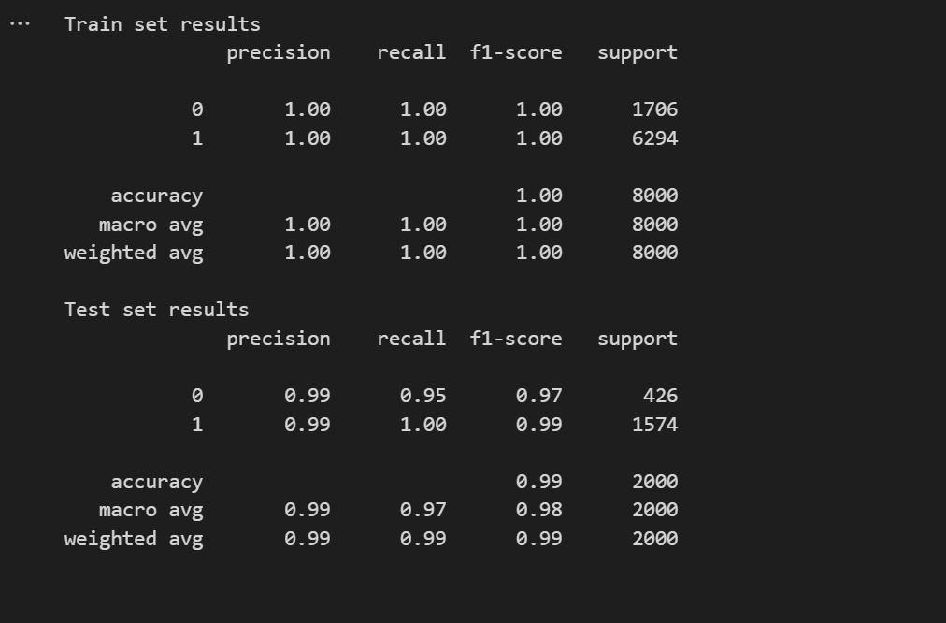
A Random Forest model is a machine learning algorithm used for both classification and regression tasks. It is built on top of Decision Trees, but instead of using just one tree, it creates multiple decision trees and combines their outputs for more robust and accurate predictions.
The image shows the classification report for a machine learning model trained and tested on the automobile dataset. The model suggest that the training and test accuracy are almost the same and are higher than the acceptable performance making the model a good fit.

Slide 38
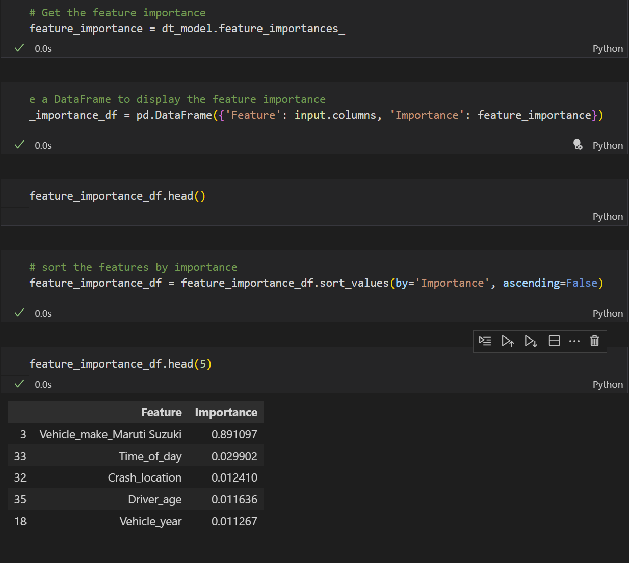
This slide answers the Machine Learning business question.
Which top 5 features have the most impact on the crash severity?

Slide 39
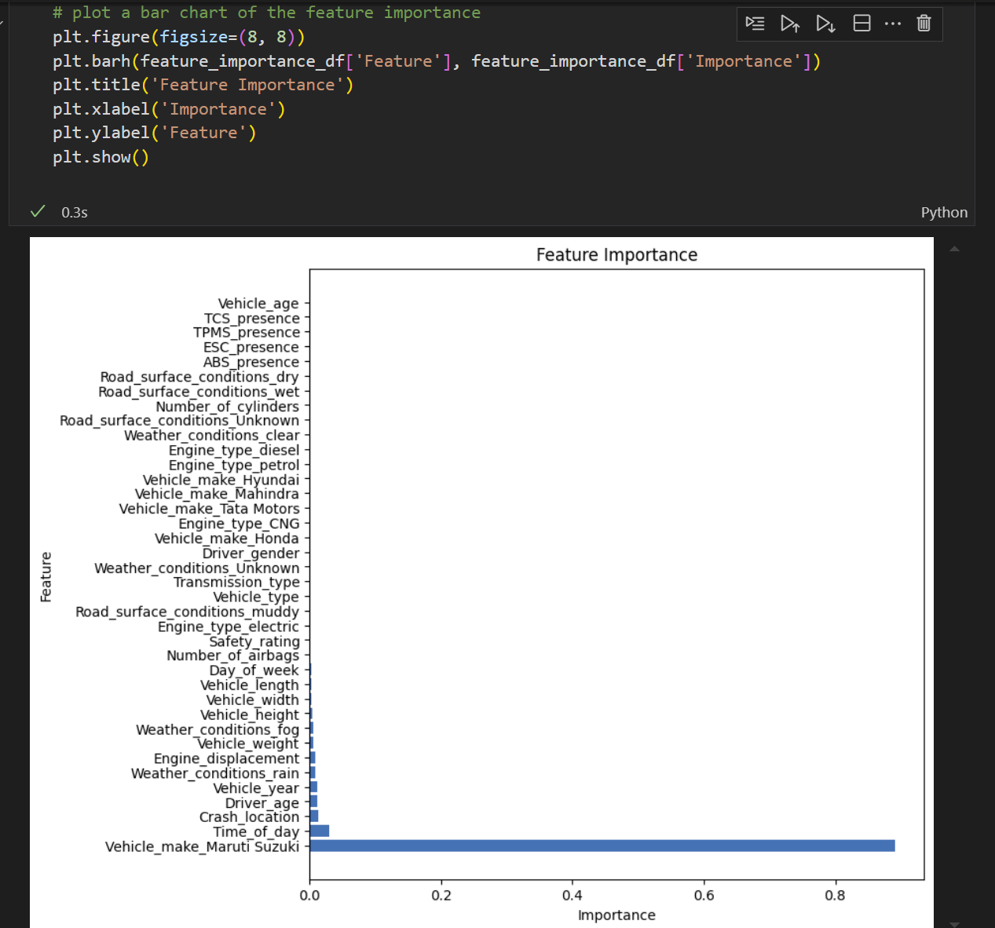
This slide displays a bar chart of the feature importance

Slide 40
Limitations of the Random Forest Model (in this project context):
Interpretability
While feature importance was shown (via a bar chart), Random Forests are still less interpretable than simpler models like logistic regression.
For stakeholders like policymakers or insurers, it might be harder to understand how specific variables influence predictions.
Dependence on Data Quality
The model's quality is directly tied to the data cleaning pipeline. While the pipeline was described as automated, any noise, inaccuracies, or missing values not properly addressed could reduce model accuracy or generalizability.
Feature Engineering Limitations
The model relies heavily on how well features were encoded and selected. While one-hot encoding was applied for nominal variables, the document doesn’t specify if more complex relationships (e.g., interactions, polynomial features) were considered, which could limit model performance.
No Causal Inference
The model identifies patterns but not causality. For example, a feature might be strongly predictive of crash severity, but the model can’t determine whether it causes the severity.
Limited Insight into Class Behavior
The presentation doesn’t provide a confusion matrix or per-class metrics for Random Forest like it did for logistic regression. This makes it hard to evaluate whether all severity levels were predicted equally well.

Slide 41
Limitations of Feature Importance Method in the Random Forest Model
1.Bias Toward High-Cardinality Features
Random Forests tend to favor features with more unique values (e.g., continuous variables) over categorical variables with fewer categories.
This can make some features look more important just because they have more potential splits, not because they’re more predictive.
2.Correlation Between Features
If two features are highly correlated, the model may split the importance between them (or attribute more to one by chance), making both appear less important than they actually are.
This can lead to misleading interpretations of which features truly drive the model.
3. Lack of Directionality
Feature importance tells you how much a variable influences the prediction, but not in which direction.
For example, it might say “driver age is important,” but doesn’t show whether older or younger drivers are associated with higher crash severity.
"Feature importance in Random Forest tells us which features the model used most, but it can sometimes overvalue variables with more data points, hide relationships between similar features, and doesn’t explain whether the impact is positive or negative."

